Slide 8
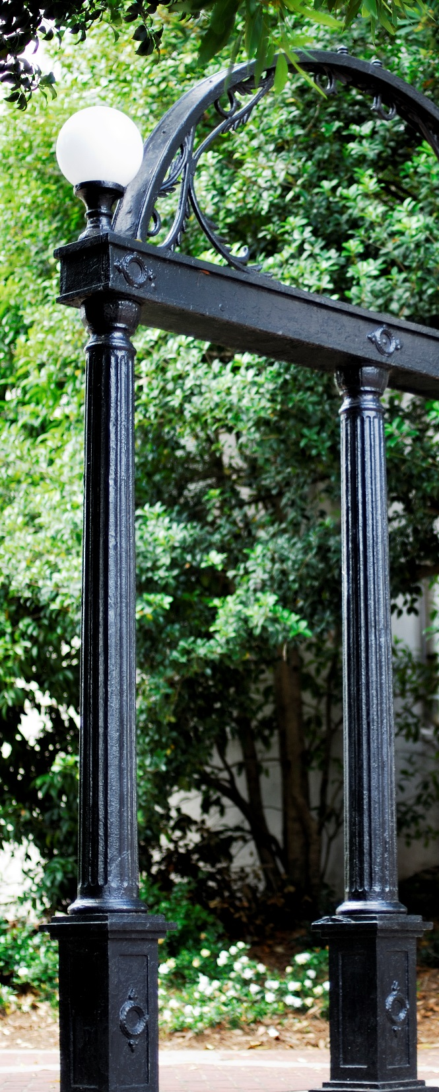
University of Georgia School of Social Work

